Slide 1


M.Tech Program
Advanced Industry Integrated Programs
Jointly offered by University and LTIMindTree
Real-Time AI-Driven Road Accident Detection and Emergency Alert System
Patel Vishrutkumar Dineshbhai
T-ID No: T8544
Knowledge partner | Implementation partner

Slide 2
Real-Time AI-Driven Road Accident Detection and Emergency Alert System
Introduction
Problem Statement:
Road accidents cause thousands of fatalities and injuries each year.
Delayed reporting and response increase the severity of outcomes.
Manual monitoring of CCTV is inefficient and prone to human error.
Solution Approach:
AI-driven system to automatically detect accidents in real-time.
Uses CCTV feeds for vehicle detection, accident recognition, and severity assessment.
Generates instant alerts for dashboards and emergency responders.
Scalable for different cities, camera types, and environments.

Slide 3
Real-Time AI-Driven Road Accident Detection and Emergency Alert System
Objective
Detect road accidents in real-time using AI and Deep Learning
Identify number of vehicles involved in the accident
Assess severity level of the incident
Send immediate alerts to monitoring dashboards & emergency teams
Reduce response time of ambulances and fire services

Slide 4
Real-Time AI-Driven Road Accident Detection and Emergency Alert System
Scope
Applicable in urban smart city traffic systems
Works with existing CCTV infrastructure
Scalable for different cities and traffic conditions
Supports integration with emergency services (ambulance, fire, police)
Future expansion: integration with IoT devices and smart vehicles

Slide 5
Real-Time AI-Driven Road Accident Detection and Emergency Alert System
Literature Review
[1] A. P. Shah, J.-B. Lamare, T. Nguyen-Anh, and A. Hauptmann, “CADP: A Novel Dataset for CCTV Traffic Camera based Accident Analysis,” in Proc. IEEE Int. Workshop on Advanced Video and Signal Based Surveillance (AVSS), 2018, pp. 1–9, doi:10.1109/AVSS.2018.8639160
[2] P. Pradeep Kumar and K. Kant, “TU-DAT: A Computer Vision Dataset on Road Traffic Anomalies,” Sensors, vol. 25, no. 11, Art. 3259, 2025, doi:10.3390/s25113259
[3] H. Liao et al., “CRASH: Crash Recognition and Anticipation System Harnessing with Context-Aware and Temporal Focus Attentions,” in Proc. ACM Int. Conf. on Multimedia (MM), 2024, doi:10.1145/3664647.3680672
[4] E. P. Ijjina, D. Chand, S. Gupta, and G. K., “Computer Vision-based Accident Detection in Traffic Surveillance,” arXiv preprint arXiv:1911.10037, Nov. 2019.

Slide 6
Real-Time AI-Driven Road Accident Detection and Emergency Alert System
Summary of Literature
CADP: A Novel Dataset for CCTV Traffic Camera Based Accident Analysis (2018)
CCTV accident dataset (1,416 videos, 205 HD annotated).
Used CM/ACM + Faster R-CNN → better small-object detection.
Accident-LSTM → forecast ~1.68s before crash, AP ~47%.
2. TU-DAT: : A Computer Vision Dataset on Road Traffic Anomalies (2025)
Dataset: ~210 CCTV + synthetic videos, richly annotated.
Includes trajectories, severity, road conditions.
Supports ML + logic-based anomaly detection.

Slide 7
Real-Time AI-Driven Road Accident Detection and Emergency Alert System
Summary of Literature…. Calibri body -36
3. CRASH : Crash Recognition and Anticipation System (2024)
Framework with object-aware + context-aware attention.
Uses FFT-based temporal context modeling.
Outperforms baselines on DAD, CCD, A3D datasets.
4. Computer Vision-based Accident Detection in Traffic Surveillance (2019)
Mask R-CNN + tracking for accident detection.
Detects anomalies in speed & trajectory.
Works robustly in varied weather/lighting.

Slide 8
Real-Time AI-Driven Road Accident Detection and Emergency Alert System
Research Gaps:
Severity Assessment
Lack of Multi-Vehicle Detection
Underused Contextual Data: Environmental context (pedestrians, weather, road type, background activity)
No End-to-End Alerting

Slide 9
Real-Time AI-Driven Road Accident Detection and Emergency Alert System
Modules to cover
Module 1: Data Collection & Preprocessing
Module 2: Vehicle Detection
Module 3: Accident Recognition
Module 4: Severity Estimation
Module 5: Real-Time Alerting System
Module 6: Central Dashboard & Reporting

Slide 10
Real-Time AI-Driven Road Accident Detection and Emergency Alert System
Module 1: Data Collection & Preprocessing
Source Datasets:
Gathered multi-format video sources from CADP, TU-DAT, and additional relevant accident datasets.
Clip Extraction & Standardization:
Manually created system-compatible clips (2–8 seconds) focusing on accident events
(around 500+ clips).
Semi-Supervised Hybrid Annotation:
Object Detection: Used YOLO for detecting vehicles and pedestrians.
Multi-Object Tracking: Employed DeepSORT (robust identity retention via appearance features) and ByteTrack (efficient, keeps low-confidence detections to improve tracking)
Accident Window & Severity Labeling:
Manually annotated accident segments.
Assigned severity labels: Low / Medium / High based on visual impact cues.

Slide 11
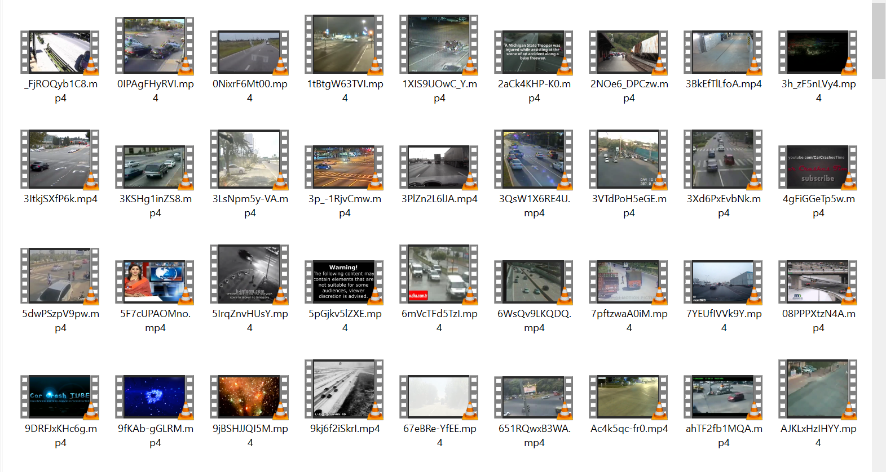
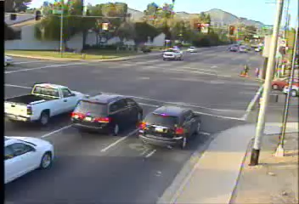
Real-Time AI-Driven Road Accident Detection and Emergency Alert System
Module 1: Data Collection & Preprocessing
Dataset Sample:

